Slide 1

Business Rules SOP
Proof-of Concept (POC)
April 2005

Slide 2
Agenda
Overview
Scope
Assumptions
Deliverables
Project Plan

Slide 3
Overview – Goals for Rules-Driven SOP Architecture
Need to Significantly Reduce Operational Costs
  Reduce Operations Staff for Monitoring & Follow-Up
  Reduce Engineering Staff for Diagnostics & Issue Resolution
Reduce Training Costs for Operations Staff
  For Initial Product Rollout & Ongoing Releases
Improve Client Satisfaction and Associate Business Interruptions Resulting from Production Errors
Improve Efficiency and Quality

Slide 4
Overview - Benefits
The Job Tracking System (JTS) will be Built using BRMS to Create an Automated Framework for:
  Automated Exception Tracking
  Automated Exception Management
    Automated Error Handling and Correction
    Foundation for Recovery Action Plan (RAP)
    Foundation for Management Action Plan (MAP)
  Automated Metrics Capture and Analysis
  Building a Foundation for Continuous Improvement & Process Efficiency
  Migration Towards a “Lights Out” MK Factory

Slide 5
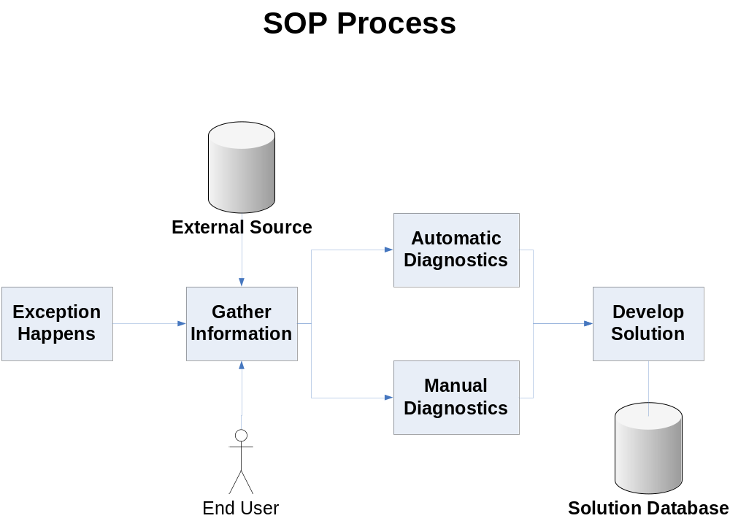
Overview – SOP Process

Slide 6
Overview – SOP Goals
Demonstrate the Concept of having Business Rule Based SOPs
Show that the Needed Information for Diagnosing and Solving Exceptions in the MK Factory Process Flow can be Captured
Test Business Rules Deployed as a Web Service
Show that SOPs for the New MK Factory can Deliver both Automatic and Manual Actions

Slide 7
Overview – SOP Goals
Show that the Business Logic for SOPs can be Stored in a Central Rule Repository and Delivered Across the MK Factory
Demonstrate that Business Rule Based SOPs can be Maintained by Operations
Show That Operations Staff can Work with the SOPs Without having to Know Where to get Information or How to Run Automated Procedures

Slide 8
Scope – SOP Features
Test the Use of Business Rules to Support and Maintain SOP Functionality
Test both the Automatic and Manual Steps for Process Exception Handling in the Job Tracking System
Collect information from the End User and from Multiple Sources (e.g., Relational Database, Flat Files, Other Systems, etc.)
Use of an Interactive Rules Based System Web Browser Utilizing Fixed Choices Using Combo Boxes

Slide 9
Scope – SOP Features
Test the Concept of Using a Web Service for Interfacing with Human End Users
Demonstrate the Capability of Logging Process Steps and Solutions
Demonstrate Exception Based Workflow Escalation Capabilities Within the Steps of a Single Process via SMTP Distribution Lists (DL)
Demonstrate the Maintainability of Business Rules

Slide 10
Scope – SOP Features NOT Included
Free Form Text Answers for Decision Making
Ability for Other Applications to Interact with the Rule Web Service for Information
SOP Refinement
Metrics Development and Demonstration

Slide 11
Assumptions
Domain will be Steps in the Application Prblems with JBoss
Operations will be made Available As Needed in a Timely Manner
Scheduled BRMS Staff will not be Diverted for Other Purposes

Slide 12
Assumptions
No use of DBA, QA, and QE resources needed for a POC
Operations Staff will Not Author or Maintain Business Rules for POC
Test Input Events will come from a File, They will NOT be from a Real Source
BRMS Team will Develop the Object Model and Data Model for the POC

Slide 13
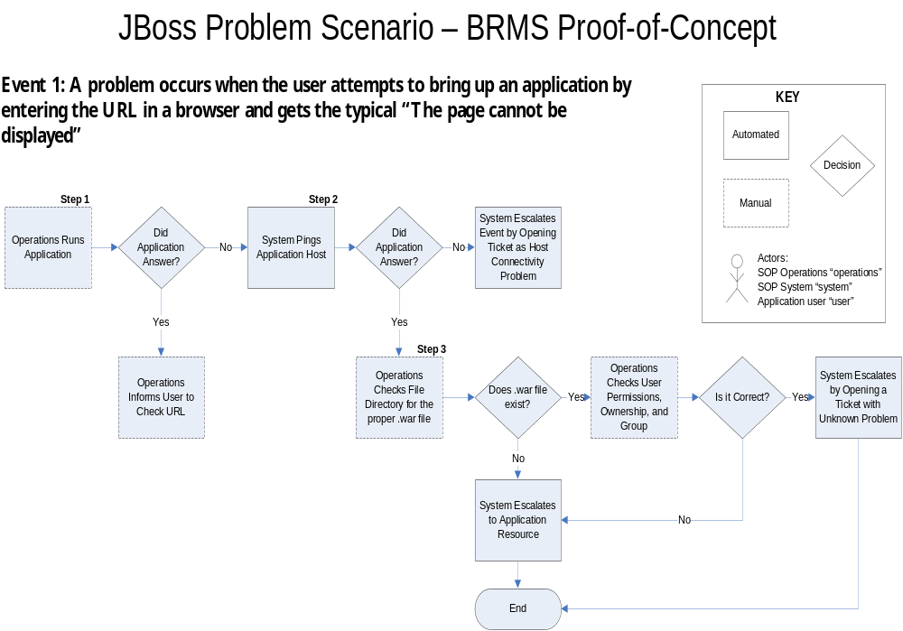
Assumptions – JBoss Event 1 Scenarios To Be Demonstrated

Slide 14
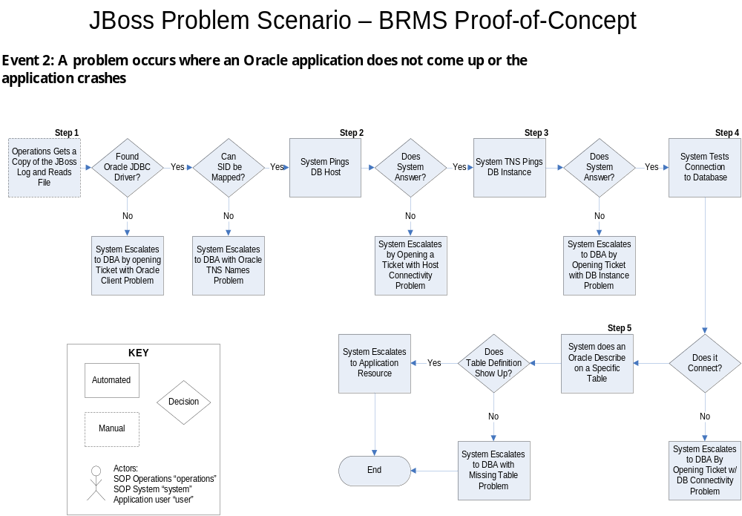
Assumptions – JBoss Scenarios Event 2 To Be Demonstrated

Slide 15
Deliverables
A Presentation and Demonstration Explaining the Concepts
An Architectural Framework for Developing an SOP Project for Business Rules Based SOPs for the New MK Factory that Can Be Used to Develop Design Specifications
Decide Who should Author & Maintain Business Rules for SOPs (i.e., Operation Staff, Engineers, DBAs, Administration, Combinations, etc.)

Slide 16
Project Plan – Key Tasks
Develop Requirements Documentation
Develop Database
Develop Object Model
Develop Rule Service
Develop User Interface
Develop Business Rules
Develop Presentation and Demonstration
Perform Presentation and Demonstration
Final Sign Off on Deliverables

